Slide 1

Artificial Neural Networks
Talib Sir
AI/ML

Slide 2
Introduction to Artificial Neural Networks
Artificial Neural Networks (ANN) are algorithms based on brain function and are used to model complicated patterns and forecast issues. The Artificial Neural Network (ANN) is a deep learning method that arose from the concept of the human brain Biological Neural Networks. The development of ANN was the result of an attempt to replicate the workings of the human brain. The workings of ANN are extremely similar to those of biological neural networks, although they are not identical. ANN algorithm accepts only numeric and structured data.

Slide 3
What is Artificial Neural Network(ANN)?
An Artificial Neural Network (ANN) is a computational model inspired by the human brain’s neural structure. It consists of interconnected nodes (neurons) organized into layers. Information flows through these nodes, and the network adjusts the connection strengths (weights) during training to learn from data, enabling it to recognize patterns, make predictions, and solve various tasks in machine learning and artificial intelligence.

Slide 4
Artificial Neural Networks Architecture
There are three layers in the network architecture: the input layer, the hidden layer (more than one), and the output layer. Because of the numerous layers are sometimes referred to as the MLP (Multi-Layer Perceptron).
It is possible to think of the hidden layer as a “distillation layer,” which extracts some of the most relevant patterns from the inputs and sends them on to the next layer for further analysis. It accelerates and improves the efficiency of the network by recognizing just the most important information from the inputs and discarding the redundant information.
The activation function is important for two reasons: first, it allows you to turn on your computer.
This model captures the presence of non-linear relationships between the inputs.
It contributes to the conversion of the input into a more usable output.

Slide 5
Artificial Neural Networks Architecture
4- Finding the “optimal values of W — weights” that minimize prediction error is critical to building a successful model. The “backpropagation algorithm” does this by converting ANN into a learning algorithm by learning from mistakes. It is possible to think of the hidden layer as a “distillation layer,” which extracts some of the most relevant patterns from the inputs and sends them on to the next layer for further analysis. It accelerates and improves the efficiency of the network by recognizing just the most important information from the inputs and discarding the redundant information.
5- The optimization approach uses a “gradient descent” technique to quantify prediction errors. To find the optimum value for W, small adjustments in W are tried, and the impact on prediction errors is examined. Finally, those W values are chosen as ideal since further W changes do not reduce mistakes.

Slide 6
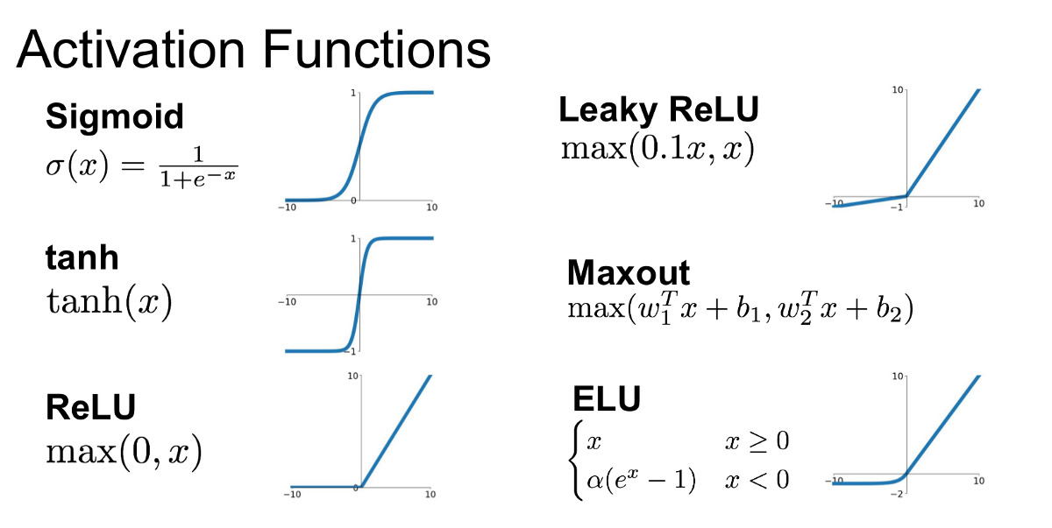
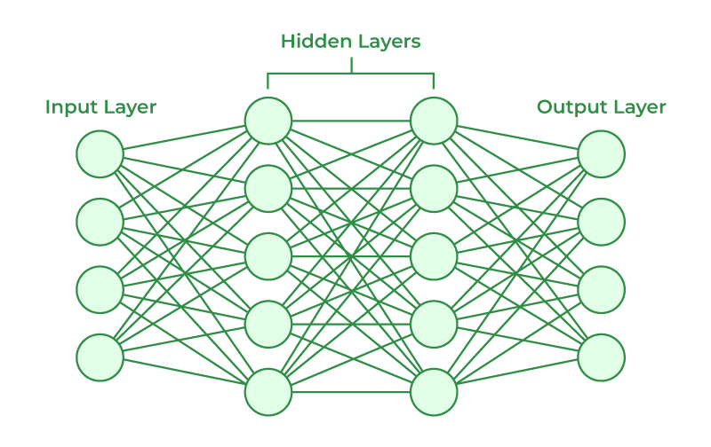

Slide 7
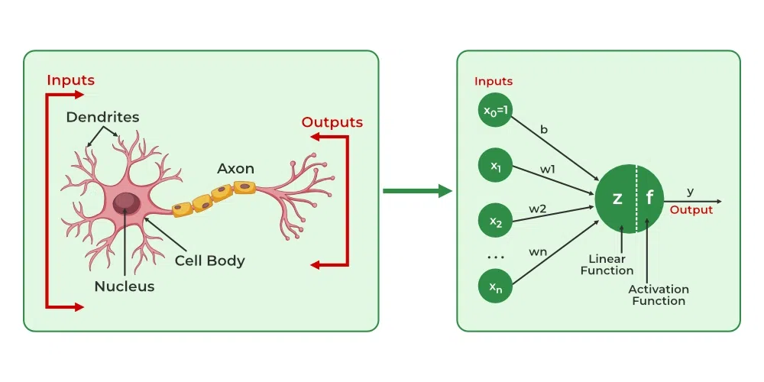
What is Perceptron?
Perceptron is one of the simplest Artificial neural network architectures. It was introduced by Frank Rosenblatt in 1957s. It is the simplest type of feedforward neural network, consisting of a single layer of input nodes that are fully connected to a layer of output nodes. It can learn the linearly separable patterns. it uses slightly different types of artificial neurons known as threshold logic units (TLU). it was first introduced by McCulloch and Walter Pitts in the 1940s.

Slide 8
Types of Perceptron
Single-Layer Perceptron: This type of perceptron is limited to learning linearly separable patterns. effective for tasks where the data can be divided into distinct categories through a straight line.
Multilayer Perceptron: Multilayer perceptrons possess enhanced processing capabilities as they consist of two or more layers, adept at handling more complex patterns and relationships within the data.

Slide 9
Basic Components of Perceptron
Input Features: The perceptron takes multiple input features, each input feature represents a characteristic or attribute of the input data.
Weights: Each input feature is associated with a weight, determining the significance of each input feature in influencing the perceptron’s output. During training, these weights are adjusted to learn the optimal values.
Summation Function: The perceptron calculates the weighted sum of its inputs using the summation function. The summation function combines the inputs with their respective weights to produce a weighted sum.
Activation Function: The weighted sum is then passed through an activation function. Perceptron uses Heaviside step function functions. which take the summed values as input and compare with the threshold and provide the output as 0 or 1.
Output: The final output of the perceptron, is determined by the activation function’s result. For example, in binary classification problems, the output might represent a predicted class (0 or 1).
Bias: A bias term is often included in the perceptron model. The bias allows the model to make adjustments that are independent of the input. It is an additional parameter that is learned during training.

Slide 10
Limitations of Perceptron
The perceptron was an important development in the history of neural networks, as it demonstrated that simple neural networks could learn to classify patterns. However, its capabilities are limited:
The perceptron model has some limitations that can make it unsuitable for certain types of problems:
Limited to linearly separable problems.
Convergence issues with non-separable data
Requires labeled data
Sensitivity to input scaling
Lack of hidden layers

Slide 11
Q&A(Perceptron)
1. What is the Perceptron model in Machine Learning?
The perceptron is a linear algorithm in machine learning employed for supervised learning tasks involving binary classification. It serves as a foundational element for understanding both machine learning and deep learning, comprising weights, input values or scores, and a threshold.
2. What is Binary classifier in Machine Learning?
A binary classifier in machine learning is a type of algorithm designed to categorize input data into two distinct classes or categories. The goal is to assign each input instance to one of the two classes based on its features or characteristics.
3. What are the basic components of Perceptron?
The basic components of a perceptron include input values or features, weights associated with each input, a summation function, an activation function, a bias term, and an output. These elements collectively enable the perceptron to learn and make binary classifications in machine learning tasks.
4. What is the Perceptron Learning Algorithm?
The Perceptron Learning Algorithm is a binary classification algorithm used in supervised learning. It adjusts weights associated with input features iteratively based on misclassifications, aiming to find a decision boundary that separates classes. It continues until all training examples are correctly classified or a predefined number of iterations is reached.
5. What is the difference between Perceptron and Multi-layer Perceptron?
The Perceptron is a single-layer neural network used for binary classification, learning linearly separable patterns. In contrast, a Multi-layer Perceptron (MLP) has multiple layers, enabling it to learn complex, non-linear relationships. MLPs have input, hidden, and output layers, allowing them to handle more intricate tasks compared to the simpler Perceptron.

Slide 12
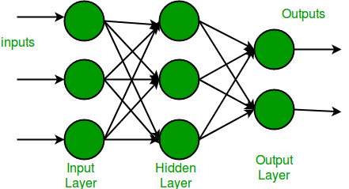
What is Multi-layer Networks?
Multi-layer Neural Networks A Multi-Layer Perceptron (MLP) or Multi-Layer Neural Network contains one or more hidden layers (apart from one input and one output layer). While a single layer perceptron can only learn linear functions, a multi-layer perceptron can also learn non – linear functions.
This neuron takes as input x1,x2,….,x3 (and a +1 bias term), and outputs f(summed inputs+bias), where f(.) called the activation function. The main function of Bias is to provide every node with a trainable constant value (in addition to the normal inputs that the node receives). Every activation function (or non-linearity) takes a single number and performs a certain fixed mathematical operation on it.

